Slide 1
Meeting 10
Tuesday 27/03/2018

Slide 2
Agenda
LES
Wind turbine and output
LES output
Turbulence intensity
Wind profile
Inflow profile
Comparison WMR & LES wind speeds
Horizontal profile
Next steps
Midterm meeting

Slide 3
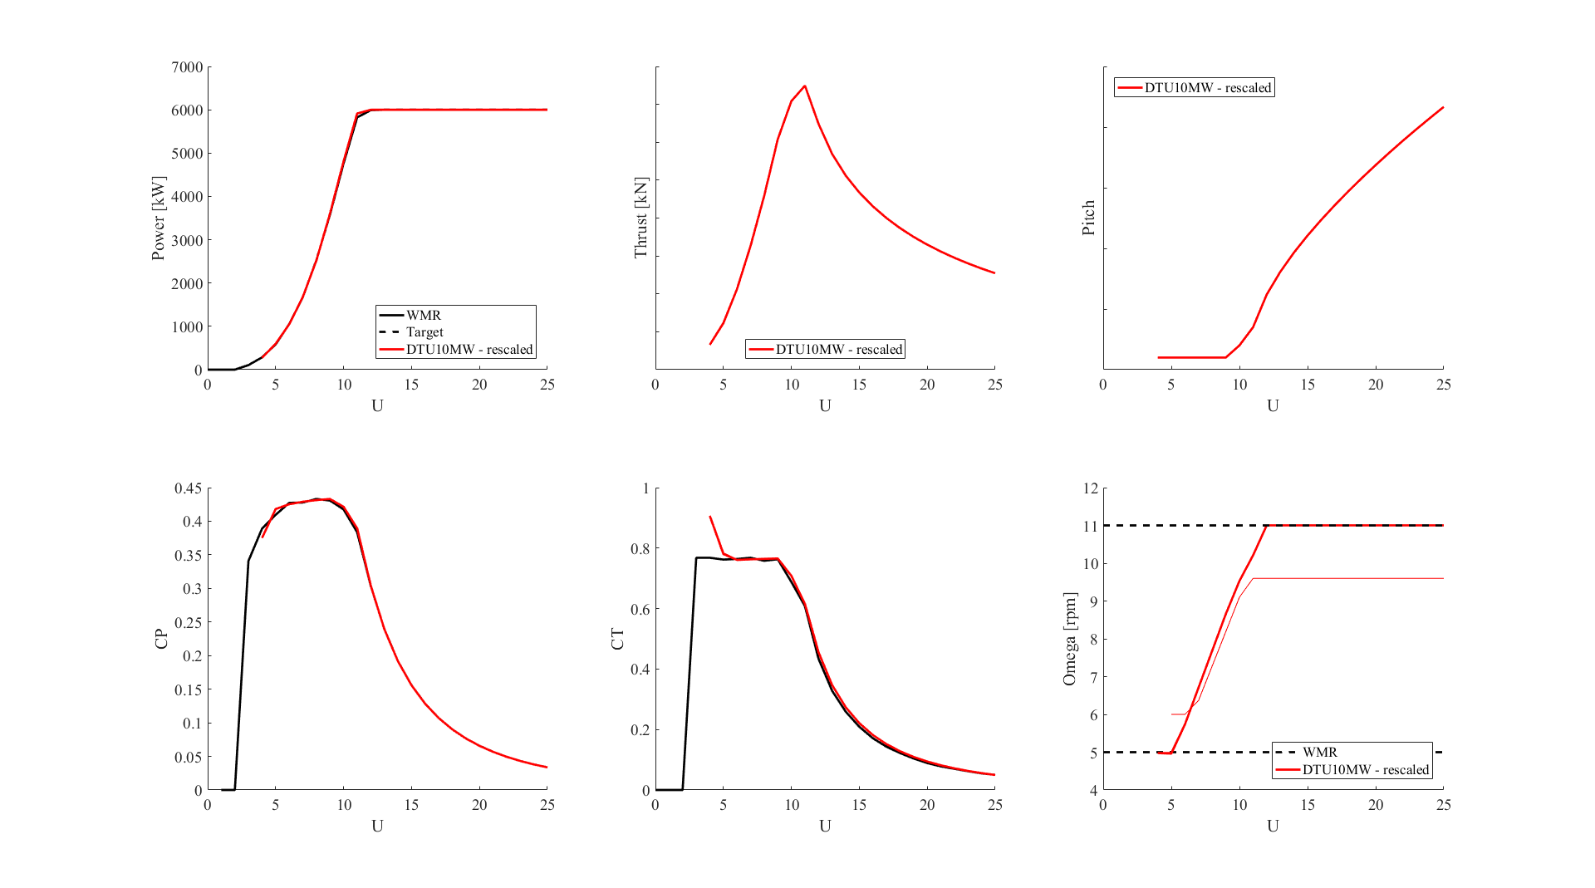
1a. LES Wind turbine

Slide 4
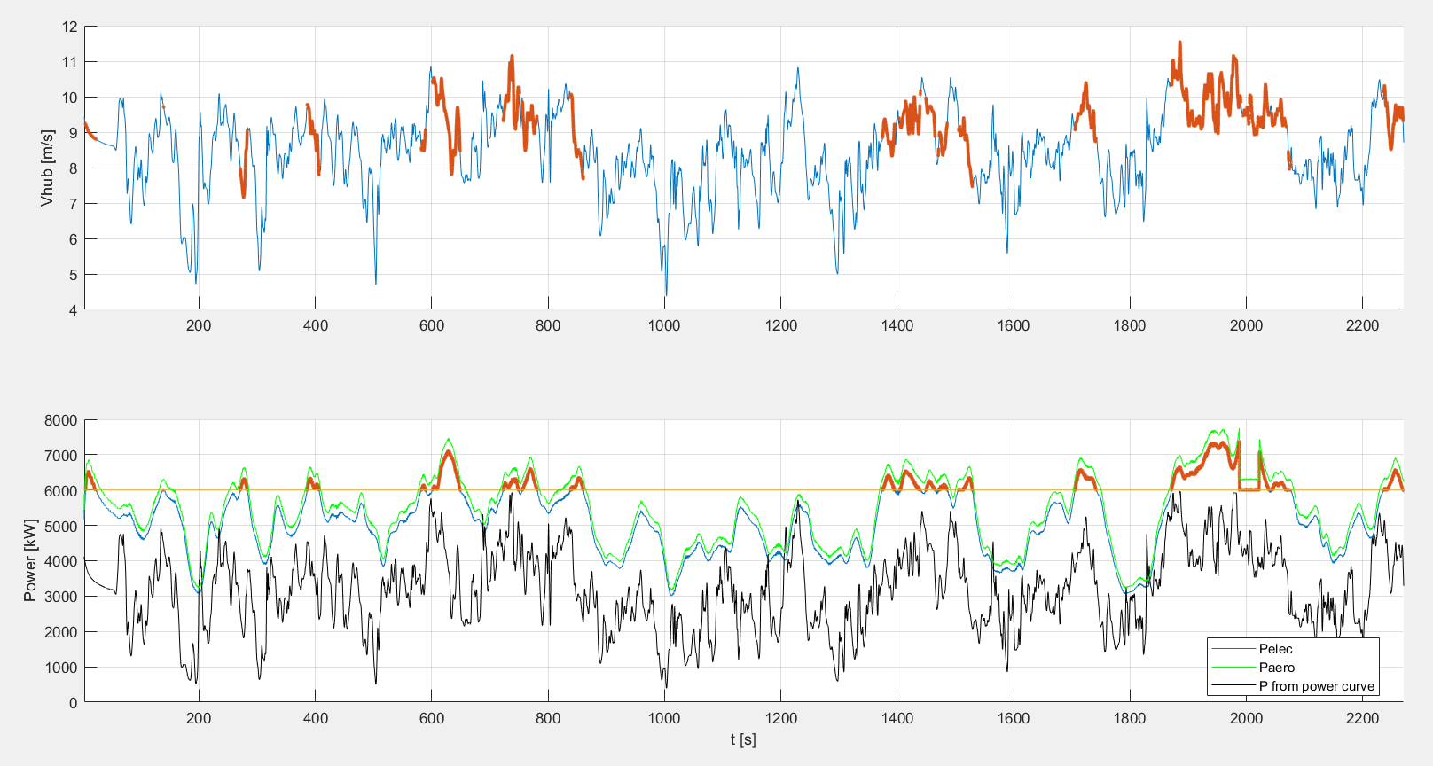
1b. LES output (Case 3)
Notes:
Mean ( Pelec / Pfrom power curve)=1,844

Slide 5
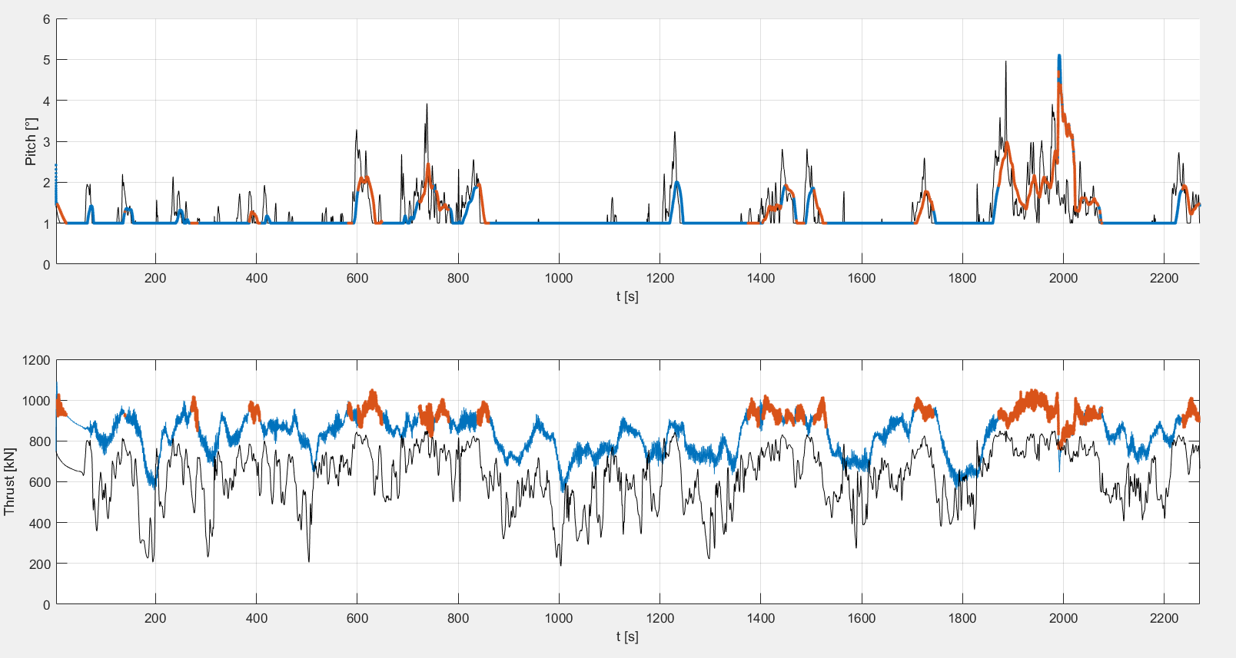
1b. LES output(Case 3)

Slide 6
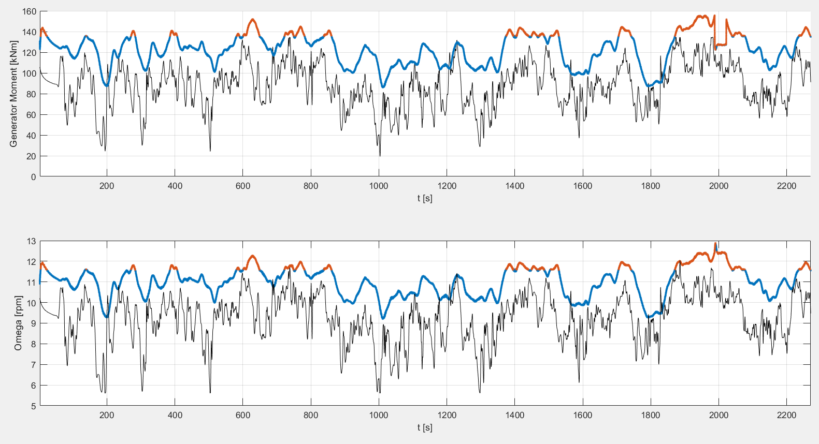
1b. LES output(Case 3)

Slide 7
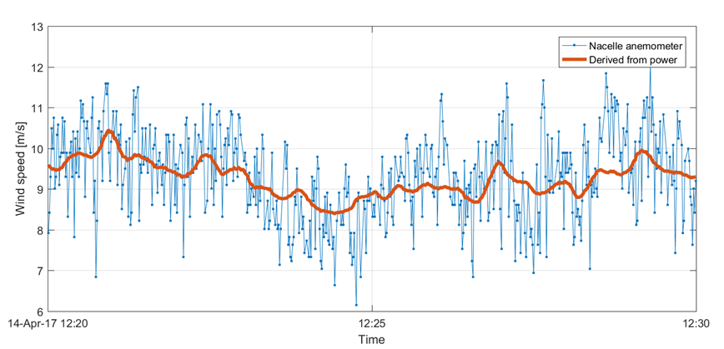
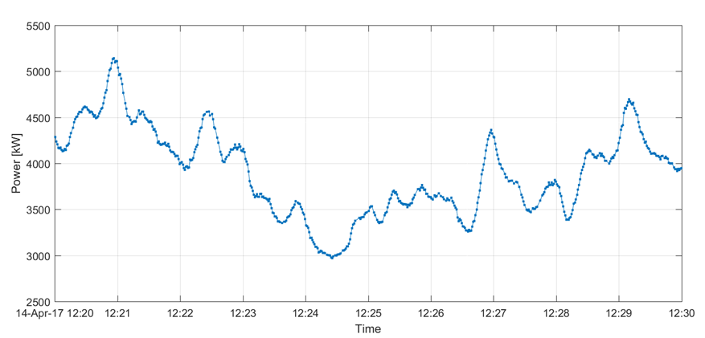
2. Turbulence Intensity BEACon (Case 3)
Nacelle anemometer and power production of wind turbine A01
The TI based on the nacelle anemometer over this 10-minute period is 11.7%.
The TI based on the wind speed derived from the power data is only 4.6%.
(Calculations by Nicolai)

Slide 8
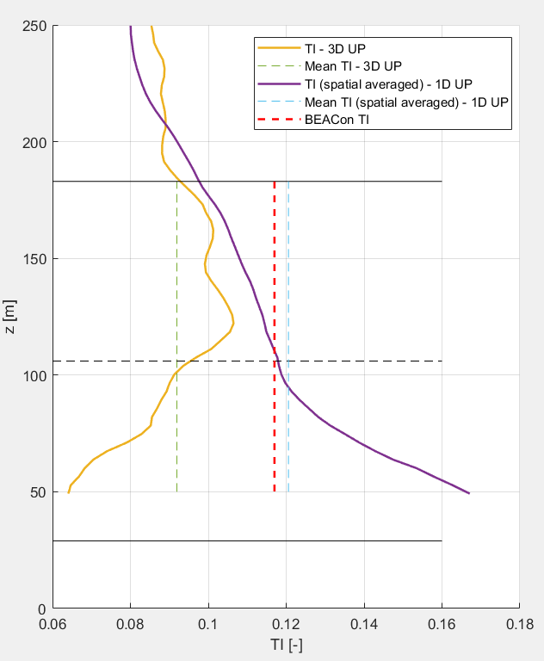
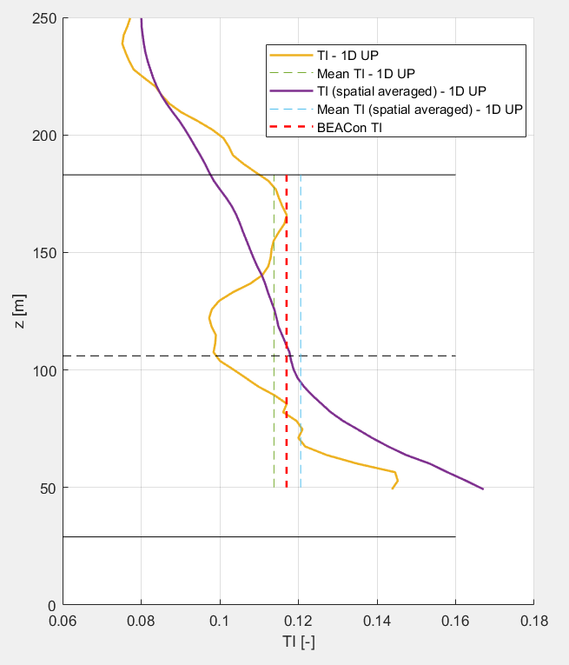
2. Turbulence Intensity LES (Case 3)
TI based on 10-min averages
Turbulence is imposed in planes at 3,95D upstream of the first turbine
TI calculated at different positions downstream

Slide 9
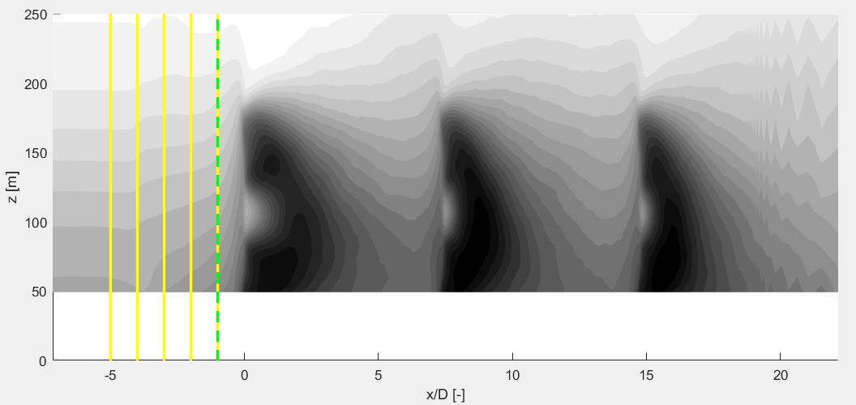
3a. Inflow wind profile
Inflow profile BEACon: spatial averaged velocity (cross-stream plane)
Inflow profile LES
Yellow: data only from one line
Yellow-green: spatial averaged velocity (cross-stream plane)

Slide 10
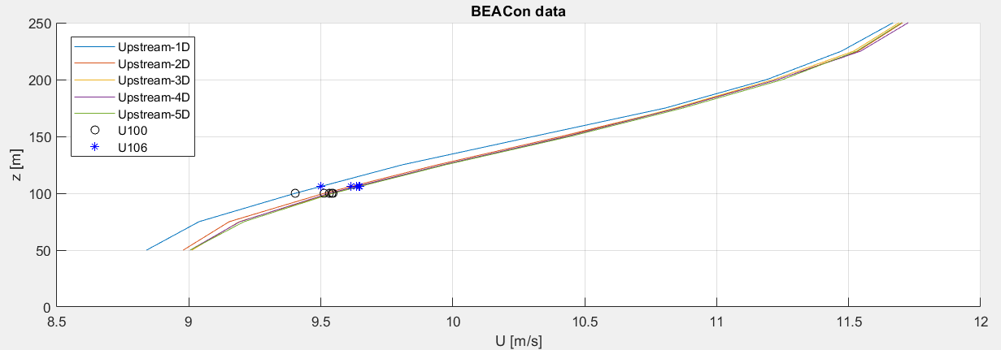
3a. Inflow wind profile: BEACon
Difference Wind speed at 100m and 106m
U0 is actually at 100m –> gives already too low input velocity for LES
Spatial averaged inflow wind profile (Case 3)

Slide 11
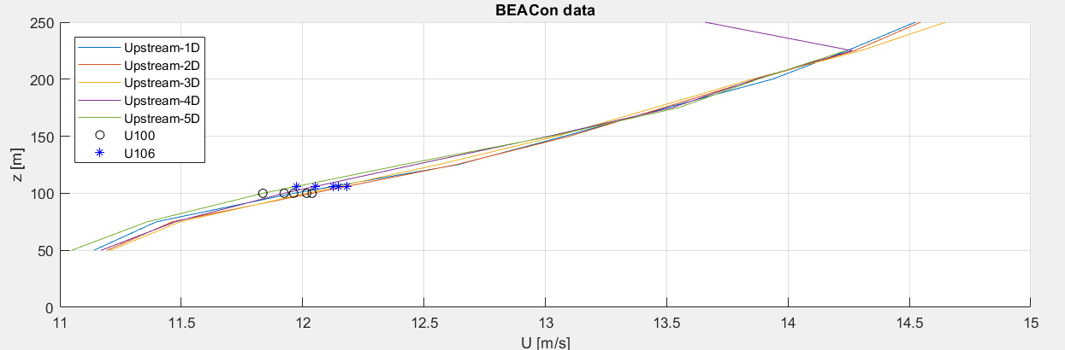
3a. Inflow wind profile: WMR
Spatial averaged inflow wind profile (Case 1)

Slide 12
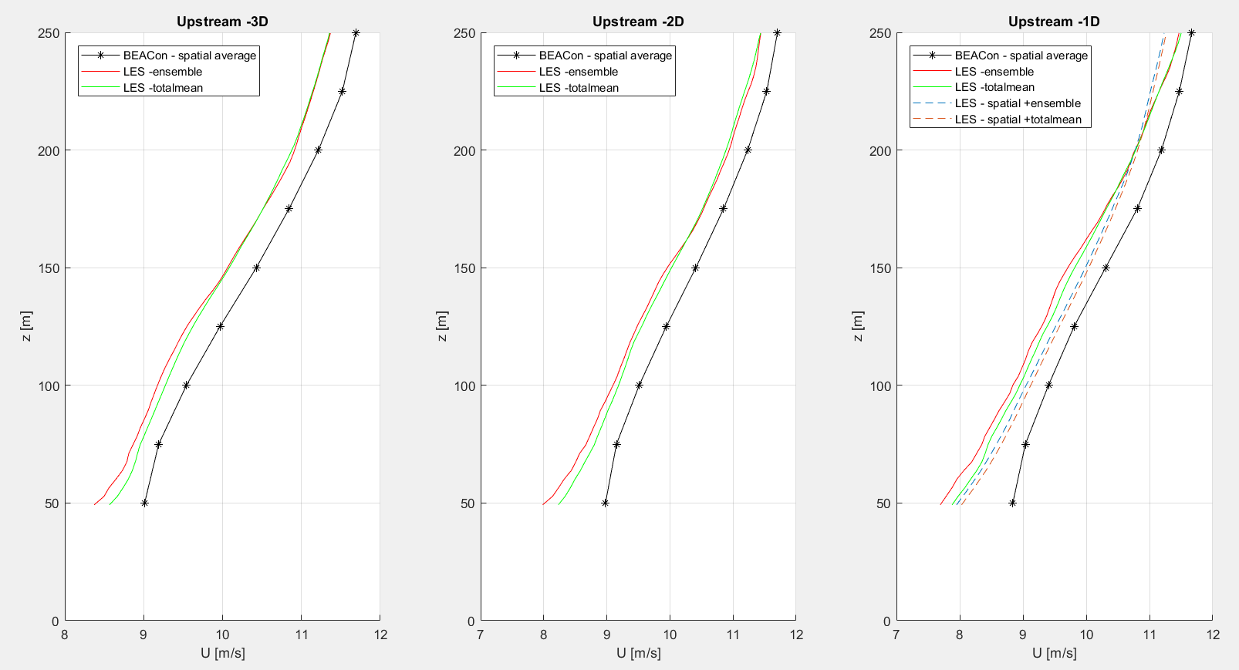
3a. Comparison WMR & LES wind profiles (Case 3)
Inflow profiles at different upstream positions
Where do we want to match them?

Slide 13
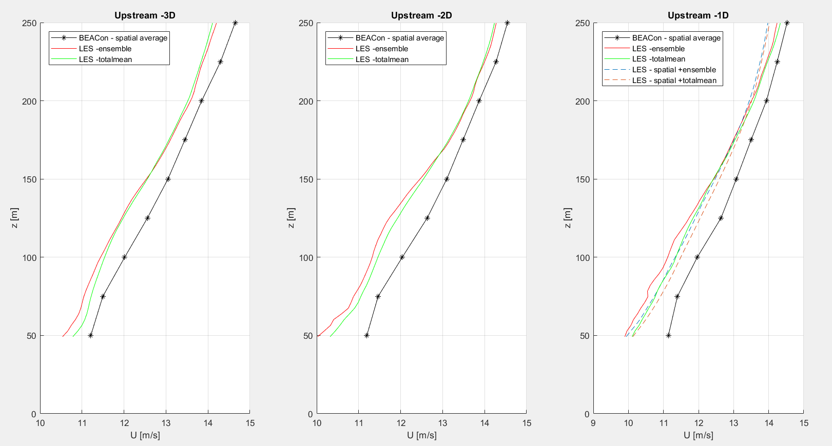
3a. Comparison WMR & LES wind profiles (Case 1)
Inflow profiles at different upstream positions
Where do we want to match them?

Slide 14
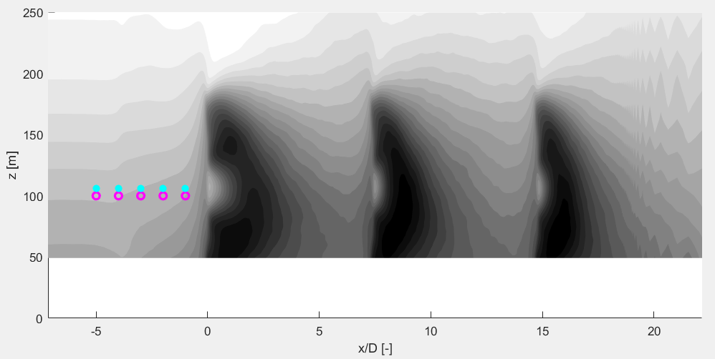
3a. Inflow wind profile
Inflow profile BEACon: spatial averaged velocity (cross-stream plane)
Inflow profile LES: data only from one point
Blue: 106m height (hub) Pink: 100m height

Slide 15
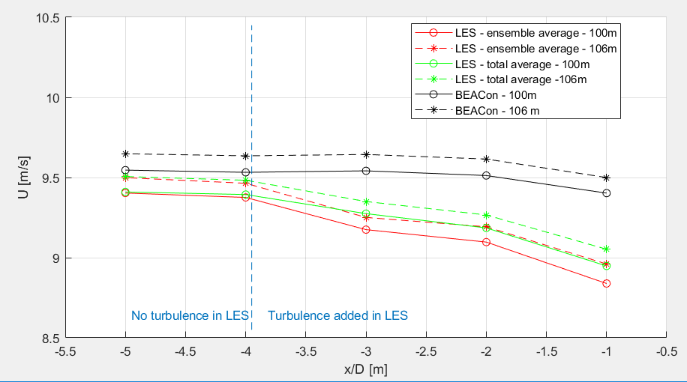
3b. Comparison WMR & LES wind speeds
Wind speed at 100m and 106m: BEACon and LES
Case 3

Slide 16
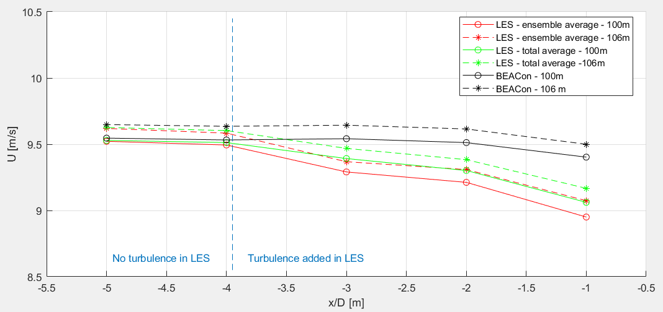
3b. Comparison WMR & LES wind speeds
Wind speed at 100m and 106m: BEACon & LES with scaling (log(106)/log(100))
Case 3

Slide 17
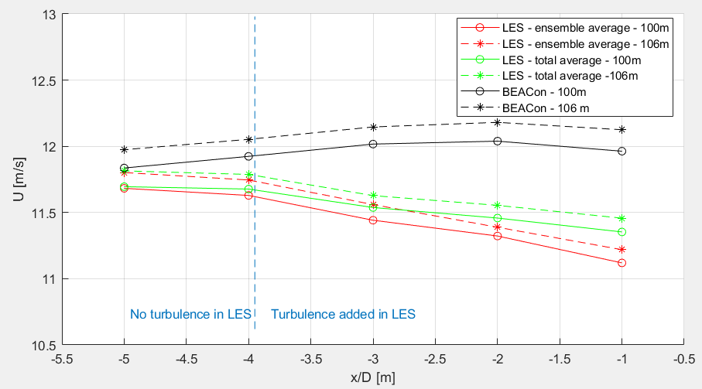
3b. Comparison WMR & LES wind speeds
Wind speed at 100m and 106m: BEACon and LES
Case 1

Slide 18
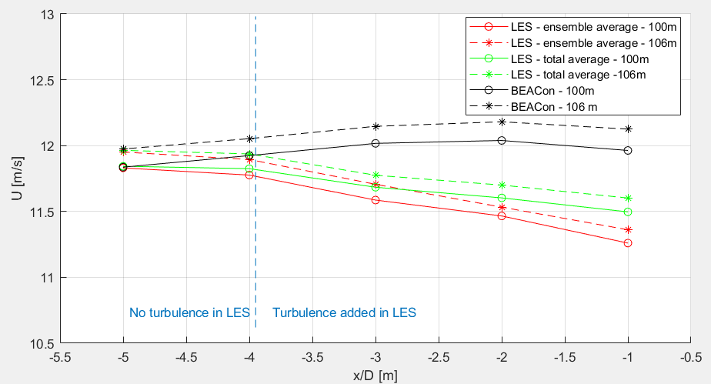
3b. Comparison WMR & LES wind speeds
Wind speed at 100m and 106m: BEACon & LES with scaling (log(106)/log(100))
Case 1

Slide 19
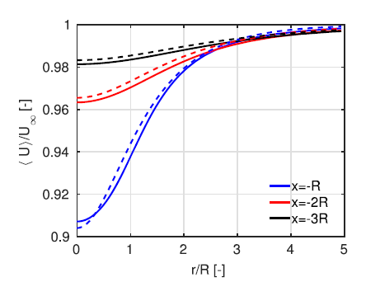
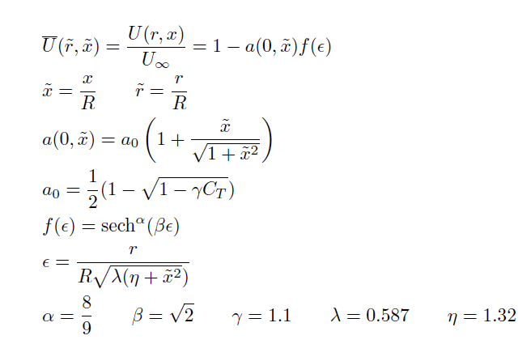
3b. Comparison WMR & LES wind speeds + simple model induction
A simple model of the wind turbine induction zone derived from numerical simulations – N.Troldborg et al.

Slide 20
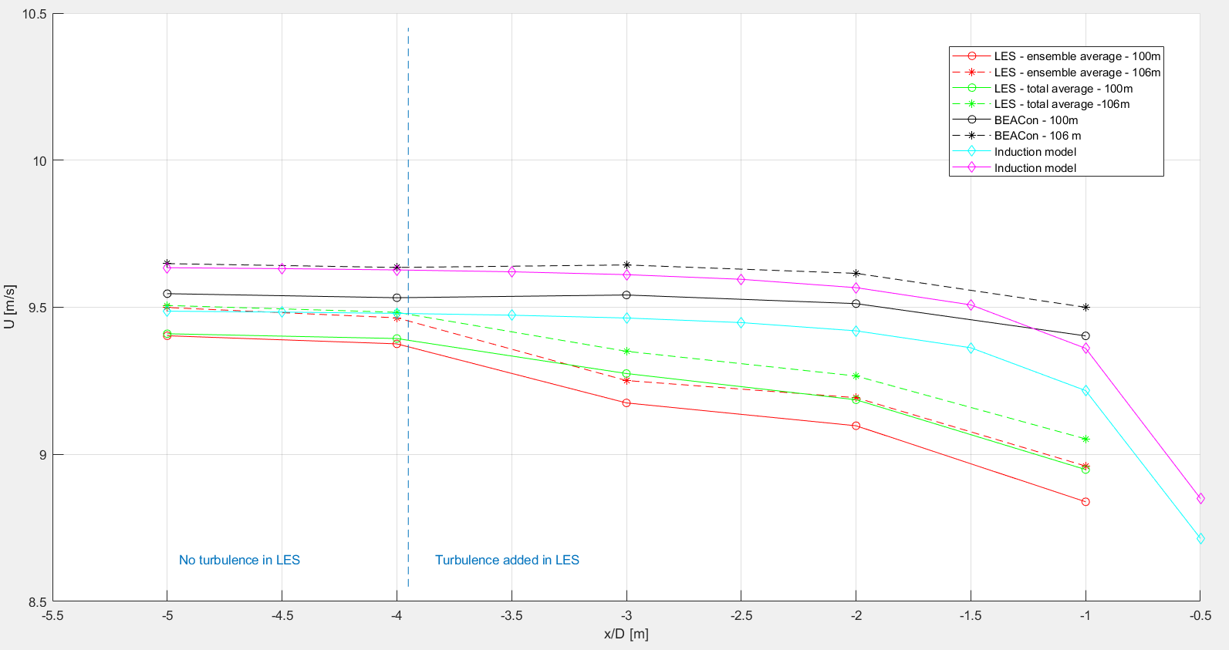
3b. Comparison WMR & LES wind speeds + simple model induction

Slide 21
4. Horizontal profile
WMR: at 100m height
LES
at 100,24 m and 107,53 m height
Spatial averaged at 100 m height

Slide 22
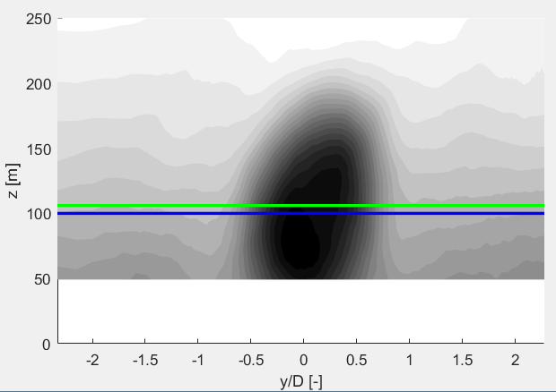
4. Horizontal profile
Notes:
At different downstream positions

Slide 23
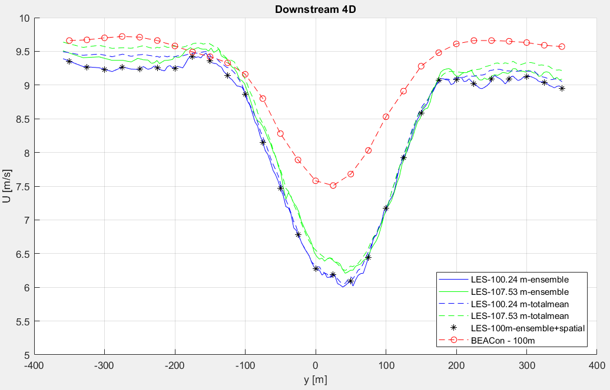
4. Horizontal profile

Slide 24
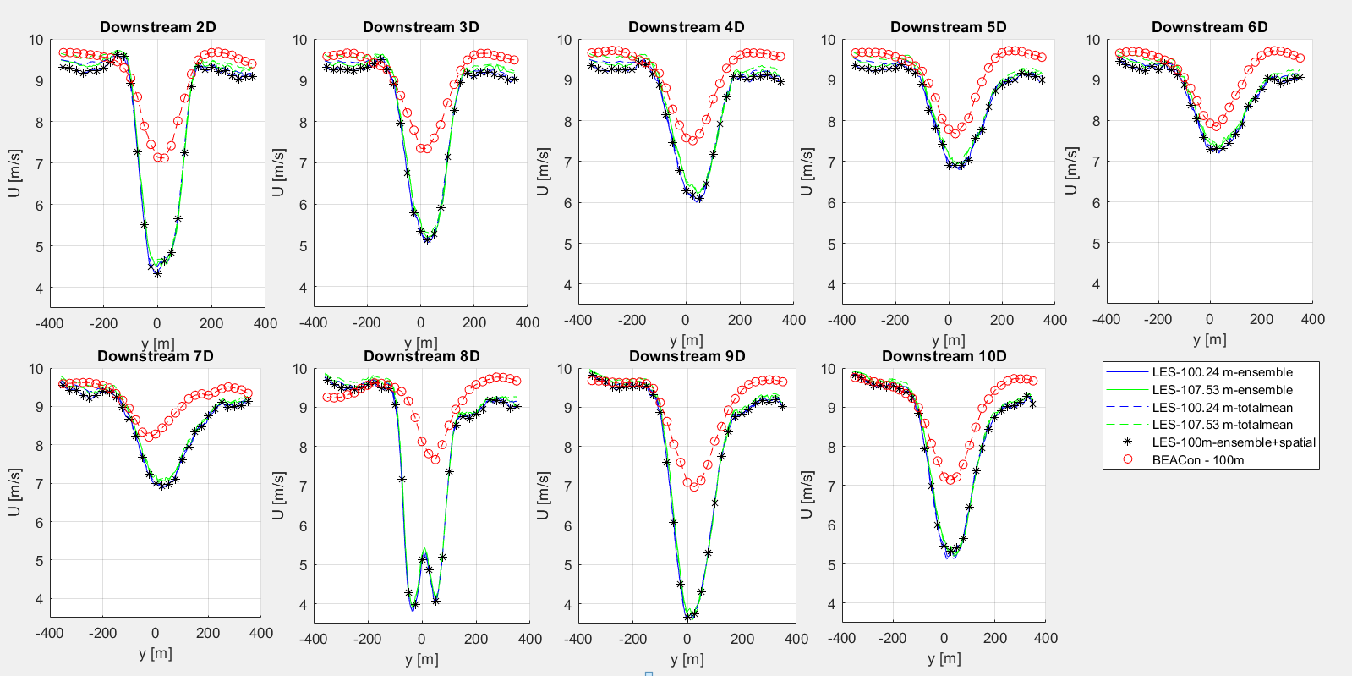

Slide 25
Next steps
New LES simulations
Turbulence Intensity
Inflow wind speed
Power spectrum (Nicolai)
Superposition of LES results
Comparison wind field 1WT and wind field 3WT

Slide 26
Midterm meeting
Monday 16/04, 9:30-10:30
Calendar invitation
15-20 min presentation + questions
Draft report
Next meeting? (planned on Tuesday 10/04 at 14:00)

